Slide 1






The Culture of the Celebrity
DISCUSS:
What reality TV shows do you watch? Which reality TV show is your favourite? (Or at least, one that you enjoy partially).
Why is this your favourite?
Write down your favourite reality TV show and why on a post-it and stick it on the board.
CHALLENGE:
The concept for The Hunger Games was influenced by the reality TV-show phenomenon. Would you watch the Hunger Games if it was on TV?

Slide 2

What inspired you to write it?
Taken from a interview with Suzanne Collins
“One night, I was lying in bed, and I was channel surfing between reality TV programs and actual war coverage. On one channel, there’s a group of young people competing for I don’t even know; and on the next, there’s a group of young people fighting in an actual war. I was really tired, and the lines between these stories started to blur in a very unsettling way. That’s the moment when Katniss’s story came to me.”
By blurring this line between fact and fiction, and entertainment and suffering in her novel, what do you think Collin’s message may be?
https://www.youtube.com/watch?v=UlHMUYwMgQw
Notes:
Desensatised to it?

Slide 3

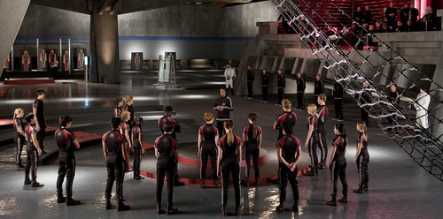
Page 96 to the end of Chapter 7
What happens in this chapter?
Can you and your partner sum it up in four points?

Slide 4

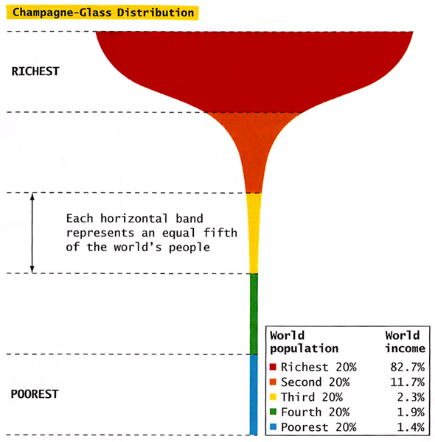
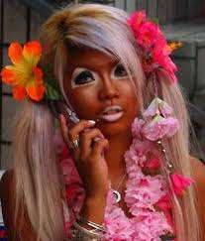
“The ancient commission of the writer has not changed. He is charged with exposing our many faults and failures for the purpose of improvement…I hold that a writer who does not passionately believe in the perfectibility of man, has no dedication nor any membership in literature.”
– John Steinbeck
“Great works of art force us to ask questions”
Notes:
What does this Steinbeck quote mean? How can we relate this to the Hunger Games?

Slide 5
Discussion
How is Katniss presented in the film clip?
Do you like the way the scene was filmed? Was it how you imagined?
How would you have directed this scene?

Slide 6
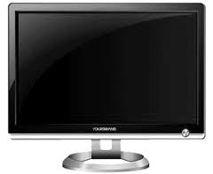
Learning Objective: To consider Suzanne Collins’ message regarding reality television
KEY QUESTION:
Considering we like this sort of show, and our generation tends to watch violent movies, is the concept of The Hunger Games that far off in society?
Consider:
How many people wanted to see the dead body of Osama Bin Laden on TV?
So…Would you watch
The Hunger Games???
Notes:
Show clip of Jeremy Kyle fight

Slide 7
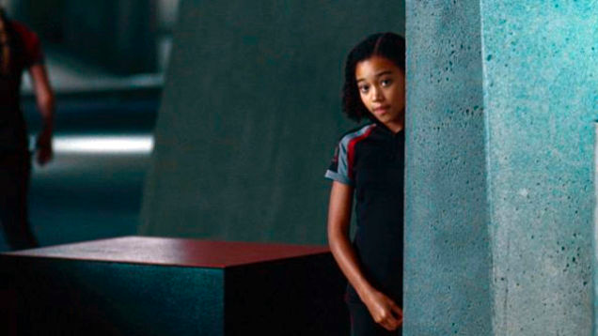

Rue
What is the meaning of the name ‘Rue’?
Who does Rue remind Katniss of? Why might this be important?
What does Rue remind Katniss of? Pick out key words.
Add a ‘Rue’ section to your Flower motif page.

